Slide 1
Finding the Civic Learning in Your Classroom
Barbara Canyes, Executive Director, Massachusetts Campus Compact
Danielle Leek, Director of Professional Learning, Campus Compact

Slide 2
Mass. Board of Higher Education, Vision Report
Civic engagement knowledge includes understanding the diverse forces (e.g., cultural, historical, economic, religious, sociological) that shape political systems and civic life through interactions among the for-profit, nonprofit, and governmental sectors.
Through higher education, students may explore privilege and positionality, and apply a critical lens to social structures that support or interfere with equity. Such analysis requires the student to confront in themselves and society forms of structural oppression and privilege that limit participation in civic and public life and decision-making.
The historic civic mission of higher education in the United States aims to prepare individuals for productive roles in society and to make civic contributions to their communities, nation, and world. The values that students bring to college have civic dimensions, and students further develop and refine these values through a range of curricular, co-curricular, and community-based experiences (ONE EXAMPLES IS SERVICE LEARNING) intentionally structured by faculty, staff, and peers. The work of civic and community engagement is complex and often involves working across diversity, difference, and power.
Service Learning develops the capacity of college students to be informed and active society members, capable of working effectively with others to address local, national, or global issues.

Slide 3
Creating Connections
Surgical Technology
Legal Studies
Nursing
Economics
Music
Theatre
There is a civic dimension to every classroom.

Slide 4
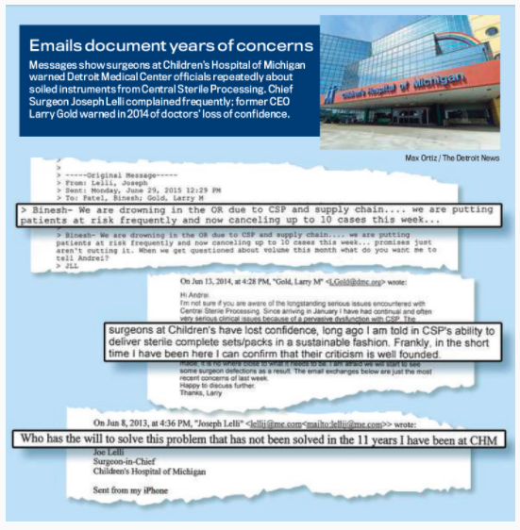
EXAMPLE: the Detroit News investigates DMC surgery center
Key Concepts Underlying Democratic Societies
Knowledge of universal democratic principles, key texts, contested ideals, and methods of conflict resolution that shape democracy in the U.S. and other nations.

Slide 5
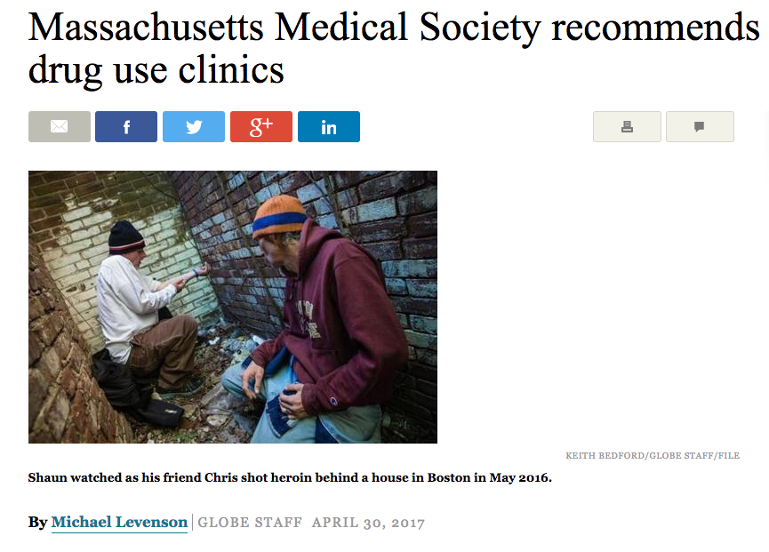
EXAMPLE: Supervised Drug Use Clinics
Relationships Between Government and Systems of Belief
Knowledge of how legal frameworks & views about systems of beliefs shape relationships between governmental institutions & civic life in the US & other nations.

Slide 6
EXAMPLE: Economics
Integrated Identity Concerning Civic Rights and Responsibilities
Knowledge of one’s own sources of identity and of the influence of integrated identity on an individual’s exercise of civic values, rights, assumptions, and responsibilities within wider ​local, national, and global ​communities

Slide 7
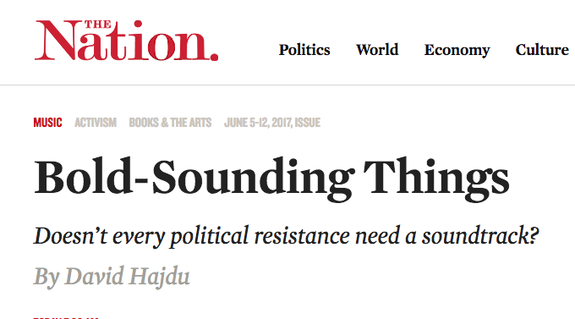
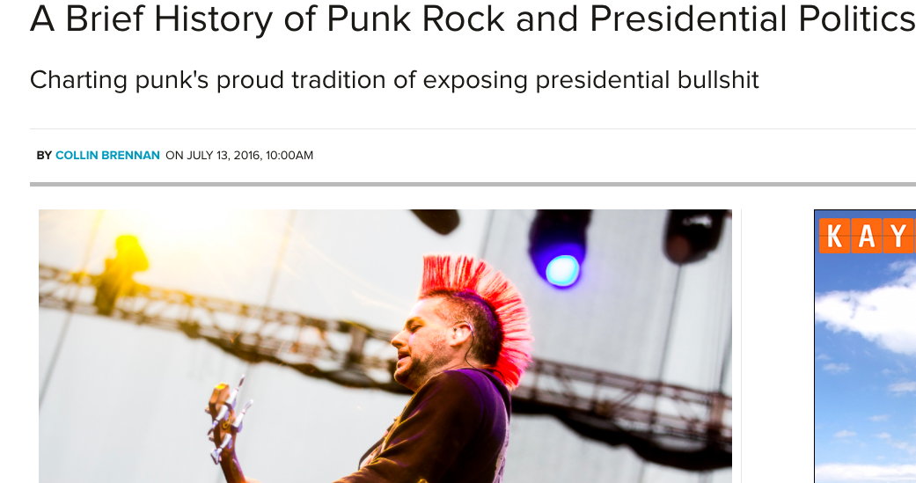
EXAMPLE: MUSIC
Social Movements
Knowledge of social movements and collective actions that have shaped societies both in the U.S. and other nations.

Slide 9
Sample Activities
Service-Learning
In-class examples from students
Role-playing
Policy debates
The Moth (Storytelling)
10 Questions reflection exercise
Community Based Research

Slide 10
Key Notes:
There is a civic dimension to all of our teaching
Students learn best when knowledge is applied
Let students guide you
Keep social justice in mind
Do not be afraid to grade
Do not be afraid NOT to grade
Remember: civic learning contributes to retention

Slide 12
Portland State University -
Senior Capstone is the culmination of the University Studies program
Capstone courses are designed by Portland State University's faculty to build cooperative learning communities by taking students out of the classroom and into the field. In Capstone courses, students bring together the knowledge, skills, and interests developed to this point through all aspects of their education, to work on a community project. Students from a variety of majors and backgrounds work as a team, pooling resources, and collaborating with faculty and community leaders to understand and find solutions for issues that are important to them as literate and engaged citizens.
http://capstone.unst.pdx.edu/courses/hunger-psu-and-portland
http://serc.carleton.edu/bioregion/courses/67876.html - Community College

Slide 13
Resources:
Mass. Board Of HIgher Education: Civic Learning Resources https://civiclearningrubric.wordpress.com
Campus Compact: www.compact.org
http://compact.org/actionstatement/knowledge-hubs/
Engaged Faculty Institute (EFI) Curriculum
http://mncampuscompact.org/what-we-do/publications/service-learning-and-academic-success-the-links-to-retention-research/

